Slide 1
ExpressRoute Partner Thursdays with the C+E Black belts & Networking team Thursday, April 7, 2016

Slide 2

Before we get started
Welcome ExpressRoute partners!!!!!
Please remember our NDA relationship
Ask questions! Use the IM window for questions
Sessions are recorded. We’ll post material @ http://aka.ms/ExpressRoutePartnerThursdays

Slide 3
Agenda
ExpressRoute from start to finish
Pre-Planning
Workload, location & partner
Pricing - Metered, Unlimited, Sizing & Premium
Understanding circuits and routing
Prerequisites
ExpressRoute Configuration
Considerations for both layer 2 and layer 3
ASN discussion
NAT discussion
Setting up the ExpressRoute circuit – New GUI interface
Adding services to ER
Open Q&A

Slide 4
ExpressRoute From Start to Finish Pre-Planning

Slide 5
Key Sales Triggers
Storage: Private, high-throughput access facilitates periodic data migration and replication for business continuity, disaster recovery and retention strategies, media upload for transcoding and StorSimple.
Dev/Test: Move large VMs back and forth between on-premises production environments and Azure Test & Development environments.
Datacenter migration: Move large quantities of VM’s from on-premises to Azure.
Hybrid Apps: High bandwidth combined with low-latency connectivity provides improved I/O and API response times allowing customers to use Azure as an extension of their data centers.
Productivity Apps: Productivity Apps (e.g., Office 365, SharePoint, SfB ) require high bandwidth, low latency pipes in order to serve end users at scale.

Slide 6















Quebec City
Toronto
Montreal
Dublin*
Amsterdam
Seattle
Chicago
New York
London
Silicon Valley
Washington DC
Tokyo
Atlanta
Osaka
Los Angeles
Dallas
Hong Kong
Chennai
Mumbai*
ExpressRoute
Singapore
Privately connect from anywhere to any Azure region
Sao Paulo
Sydney
Melbourne*
Notes:
For connecting from on-premises environments, you can choose secure VPN
We also offer private connectivity from your WAN environments using the ExpressRoute service. ExpressRoute provides speeds up to 10Gbps, latencies as low as 5ms and a predictable QoS. These connections make Microsoft datacenters perform like your own datacenter.
21 ExpressRoute locations worldwide, more than AWS or Google.
Large set of partners that offer private connectivity - enterprises can connect privately to from anywhere in the world.
Azure is the only hyperscale provider that carries traffic across regions on its backbone. So, from an ER location in Silicon Valley, we will carry the traffic to Singapore on Azure backbone.

Slide 7
ExpressRoute Pricing Models
Pricing varies based on speed of the circuit, Zone, plan type, and whether the customer chooses standard/premium Speed: 50Mbps, 100Mbps, 200Mbps, 500Mbps, 1Gbps, 2Gbps, 5Gbps and 10Gbps Zone: Zone 1( United States, Canada, Europe), Zone 2 (Asia, Australia, NZ) and Zone 3 (Latin America) Pricing Model: Unlimited: Fixed monthly fee. No limits on usage Metered: Small fixed monthly fee. Charges based on consumption (on a per-GB basis) Service Tier: Standard: Data transfer within a geo-political region, up to 10 VNETs, up to 4K routes Premium: Data transfer across geo-political regions, up to 100 VNETs, up to 10K routes Customer price points are monthly. However, charges are pro-rated on an hourly basis Available in MOSP, EA, CSP, Open and MPSA Premium service is optional for Azure traffic, but mandatory for Office 365 and CRM Online traffic Single EA agreement sufficient for Office 365 and ExpressRoute
Microsoft Azure

Slide 8
Future ExpressRoute Models (Azure)
Customer requires standard service
Customer requires premium service
 | Metered Data Plan (Standard)
Circuit Size | Zone 1 | Zone 2 | Zone 3
50 Mbps | $ 55 | $ 55 | $ 55
100 Mbps | $ 100 | $ 100 | $ 100
200 Mbps | $ 145 | $ 145 | $ 145
500 Mbps | $ 290 | $ 290 | $ 290
1 Gbps | $ 436 | $ 436 | $ 436
2 Gbps | $ 872 | $ 872 | $ 872
5 Gbps | $ 2,180 | $ 2,180 | $ 2,180
10 Gbps | $ 5,000 | $ 5,000 | $ 5,000
 | Metered Data Plan (Premium)
Cicuit Size | Zone 1 | Zone 2 | Zone 3
50 Mbps | $ 130 | $ 155 | $ 155
100 Mbps | $ 200 | $ 275 | $ 275
200 Mbps | $ 295 | $ 445 | $ 445
500 Mbps | $ 690 | $ 1,090 | $ 1,090
1 Gbps | $ 1,186 | $ 1,886 | $ 1,886
2 Gbps | $ 2,372 | $ 3,122 | $ 3,122
5 Gbps | $ 5,180 | $ 5,180 | $ 5,180
10 Gbps | $ 8,000 | $ 8,000 | $ 8,000
Existing SKUs for Office 365 and Azure customers
Data Transfer Pricing Zone 1: $0.025/GB, Zone 2: $0.050/GB, Zone 3: $0.140/GB
Data Transfer Pricing Zone 1: $0.025/GB, Zone 2: $0.050/GB, Zone 3: $0.140/GB
New SKUs for Office 365 and Azure customers
 | Unlimited Data Plan (Standard)
Cicuit Size | Zone 1 | Zone 2 | Zone 3
50 Mbps | $ 300 | $ 610 | $ 872
100 Mbps | $ 575 | $ 1,230 | $ 1,300
200 Mbps | $ 1,150 | $ 2,300 | $ 3,220
500 Mbps | $ 2,750 | $ 5,200 | $ 5,200
1 Gbps | $ 5,700 | $ 8,700 | $ 8,700
2 Gbps | $ 11,400 | $ 17,400 | $ 17,400
5 Gbps | $ 25,650 | $ 41,000 | $ 41,000
10 Gbps | $ 51,300 | $ 82,000 | $ 82,000
 | Unlimited Data Plan (Premium)
Circuit Size | Zone 1 | Zone 2 | Zone 3
50 Mbps | $ 375 | $ 710 | $ 972
100 Mbps | $ 675 | $ 1,405 | $ 1,475
200 Mbps | $ 1,300 | $ 2,600 | $ 3,520
500 Mbps | $ 3,150 | $ 6,000 | $ 6,000
1 Gbps | $ 6,450 | $ 10,150 | $ 10,150
2 Gbps | $ 12,900 | $ 19,650 | $ 19,650
5 Gbps | $ 28,650 | $ 44,000 | $ 44,000
10 Gbps | $ 54,300 | $ 85,000 | $ 85,000
Microsoft Azure

Slide 9
Future ExpressRoute Models (O365)
Customer has >= 500 Office 365 Seats
Customer has < 500 Office 365 Seats
 | Metered Data Plan for Office 365/CRM Online
Circuit Size | Zone 1 | Zone 2 | Zone 3
50 Mbps | $ 55 | $ 55 | $ 55
100 Mbps | $ 100 | $ 100 | $ 100
200 Mbps | $ 145 | $ 145 | $ 145
500 Mbps | $ 290 | $ 290 | $ 290
1 Gbps | $ 436 | $ 436 | $ 436
2 Gbps | $ 872 | $ 872 | $ 872
5 Gbps | $ 2,180 | $ 2,180 | $ 2,180
10 Gbps | $ 5,000 | $ 5,000 | $ 5,000
 | Metered Data Plan (Premium)
Cicuit Size | Zone 1 | Zone 2 | Zone 3
50 Mbps | $ 130 | $ 155 | $ 155
100 Mbps | $ 200 | $ 275 | $ 275
200 Mbps | $ 295 | $ 445 | $ 445
500 Mbps | $ 690 | $ 1,090 | $ 1,090
1 Gbps | $ 1,186 | $ 1,886 | $ 1,886
2 Gbps | $ 2,372 | $ 3,122 | $ 3,122
5 Gbps | $ 5,180 | $ 5,180 | $ 5,180
10 Gbps | $ 8,000 | $ 8,000 | $ 8,000
Data Transfer Pricing Zone 1: $0.025/GB, Zone 2: $0.050/GB, Zone 3: $0.140/GB
Data Transfer Pricing Zone 1: $0.025/GB, Zone 2: $0.050/GB, Zone 3: $0.140/GB
New SKUs for Office 365 and Azure customers
New SKUs for Office 365 customers
 | Unlimited Data Plan for Office 365/CRM Online
Circuit Size | Zone 1 | Zone 2 | Zone 3
50 Mbps | $ 300 | $ 610 | $ 872
100 Mbps | $ 575 | $ 1,230 | $ 1,300
200 Mbps | $ 1,150 | $ 2,300 | $ 3,220
500 Mbps | $ 2,750 | $ 5,200 | $ 5,200
1 Gbps | $ 5,700 | $ 8,700 | $ 8,700
2 Gbps | $ 11,400 | $ 17,400 | $ 17,400
5 Gbps | $ 25,650 | $ 41,000 | $ 41,000
10 Gbps | $ 51,300 | $ 82,000 | $ 82,000
 | Unlimited Data Plan (Premium)
Circuit Size | Zone 1 | Zone 2 | Zone 3
50 Mbps | $ 375 | $ 710 | $ 972
100 Mbps | $ 675 | $ 1,405 | $ 1,475
200 Mbps | $ 1,300 | $ 2,600 | $ 3,520
500 Mbps | $ 3,150 | $ 6,000 | $ 6,000
1 Gbps | $ 6,450 | $ 10,150 | $ 10,150
2 Gbps | $ 12,900 | $ 19,650 | $ 19,650
5 Gbps | $ 28,650 | $ 44,000 | $ 44,000
10 Gbps | $ 54,300 | $ 85,000 | $ 85,000
Microsoft Azure

Slide 10


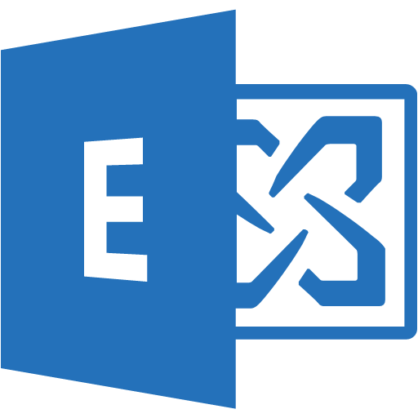

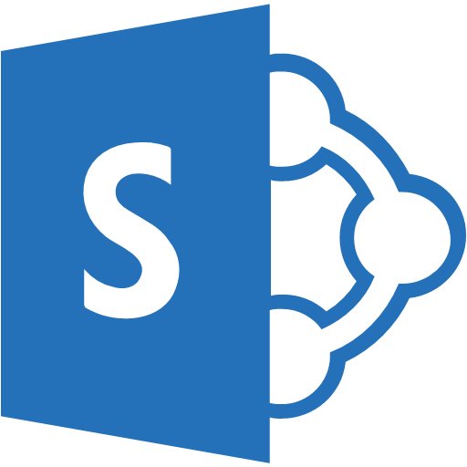














ExpressRoute & Microsoft Clouds
https://azure.microsoft.com/en-us/documentation/articles/expressroute-circuit-peerings/
O365, CRM - Microsoft Peering
Partner Edge
Microsoft Edge
Customer’s network
ExpressRoute
Circuit
Azure PaaS – Public Peering
Traffic to Office 365 Services
Traffic to public IP addresses in Azure
Traffic to Virtual Networks (VNETs)
Azure IaaS – Private Peering

Slide 11
ExpressRoute From Start to Finish Configuration

Slide 12
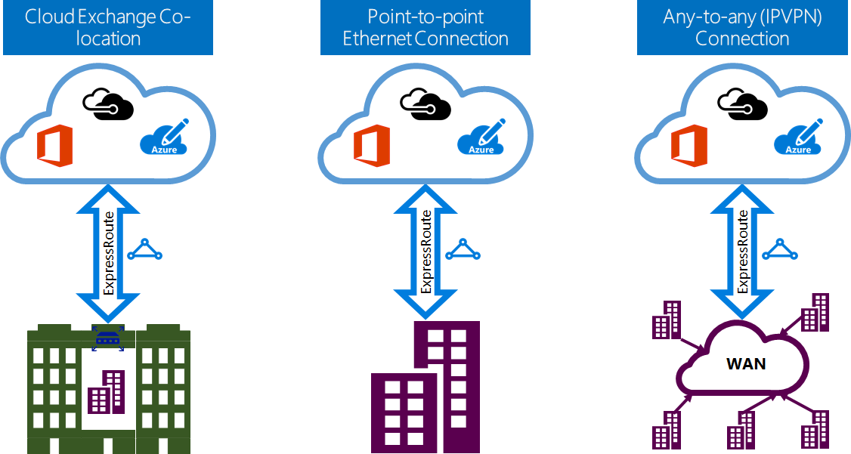
ExpressRoute deployment options
ER partner hands off a LAYER 2 service to the end customer
ER partner hands off a LAYER 3 service to the end customer

Slide 13
Layer 3 deployment
ER partner provides IP VPN, typically over MPLS backbone
The Microsoft network is exposed as an additional site in the customer’s IP VPN
ER partner is responsible for meeting IP addressing/routing requirements
ASN
IP addresses for the routing interfaces
NAT pools (might be provided by the customer as well)

Slide 14
Layer 2 deployment options
ER partner delivers layer 2 links (primary + secondary)
End customer must deploy routers (primary + secondary) to terminate the links
End customer is responsible for meeting IP addressing/routing requirements
ASN
IP addresses for the routing interfaces
NAT pools

Slide 15

Routing requirements
Microsoft & Azure Public peerings
Public ASN
Public IP addresses registered in IRR
Partner Edge
Microsoft Edge
Customer’s network
ExpressRoute
Circuit
Azure Private peering
Private or public ASN
Private or public IP addresses
https://azure.microsoft.com/en-us/documentation/articles/expressroute-routing/

Slide 16
NAT requirements
Microsoft peering
Outound traffic Source-NAT
Public, IRR-registered NAT pool
NAT pool not advertised to the internet
Inbound traffic Source-NAT
Azure Public peering
Outbound traffic Source-NAT
Public, IRR-registered NAT pool
NAT pool not advertised to the internet
Partner Edge
Microsoft Edge
Customer’s network
ExpressRoute
Circuit
Azure Private peering
Private or public ASN
Private or public IP addresses
https://azure.microsoft.com/en-us/documentation/articles/expressroute-nat/

Slide 17
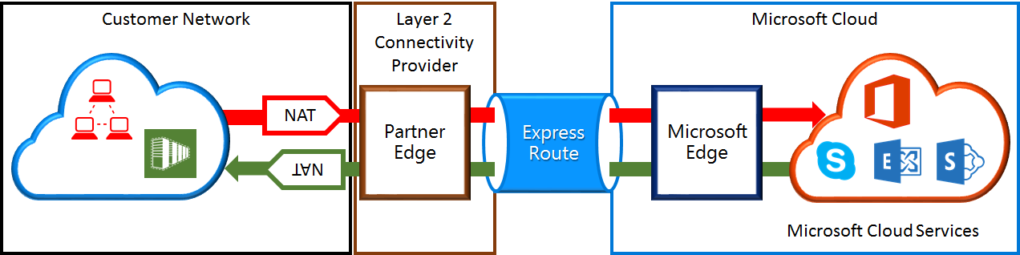
NAT requirements – Microsoft peering
https://azure.microsoft.com/en-us/documentation/articles/expressroute-nat/

Slide 18
Public ASN & Public IPs concerns
«My customer does not own a public ASN!!"
The ER partner can use its own ASN and allocate registered IP addresses to the customer
«My customer owns a public ASN and will use its public IP addresses, but the BGP session with Microsoft is established from a different ASN (the provider ASN)»
This is supported!

Slide 19
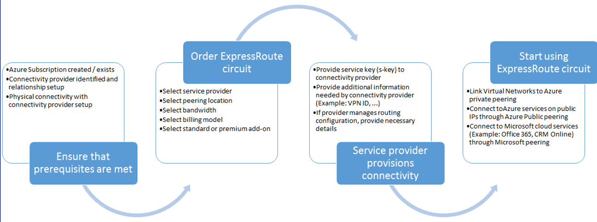
Follow the workflow
https://azure.microsoft.com/en-us/documentation/articles/expressroute-workflows/

Slide 20
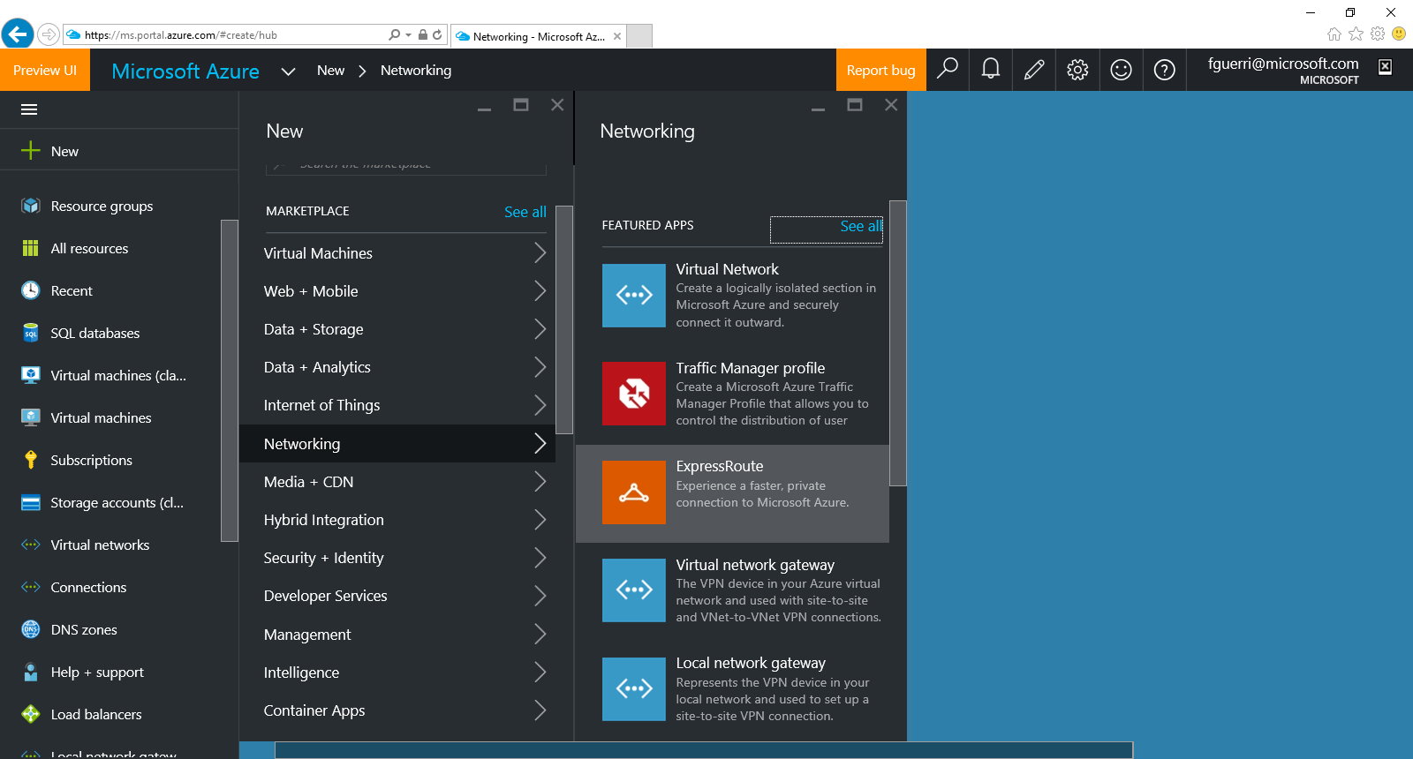
ER is now supported in the Azure Portal

Slide 21
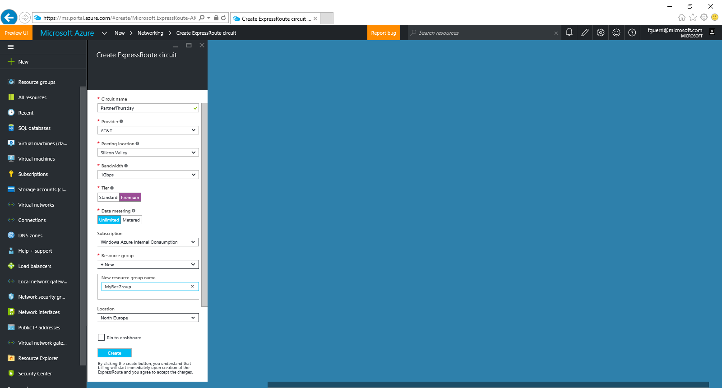
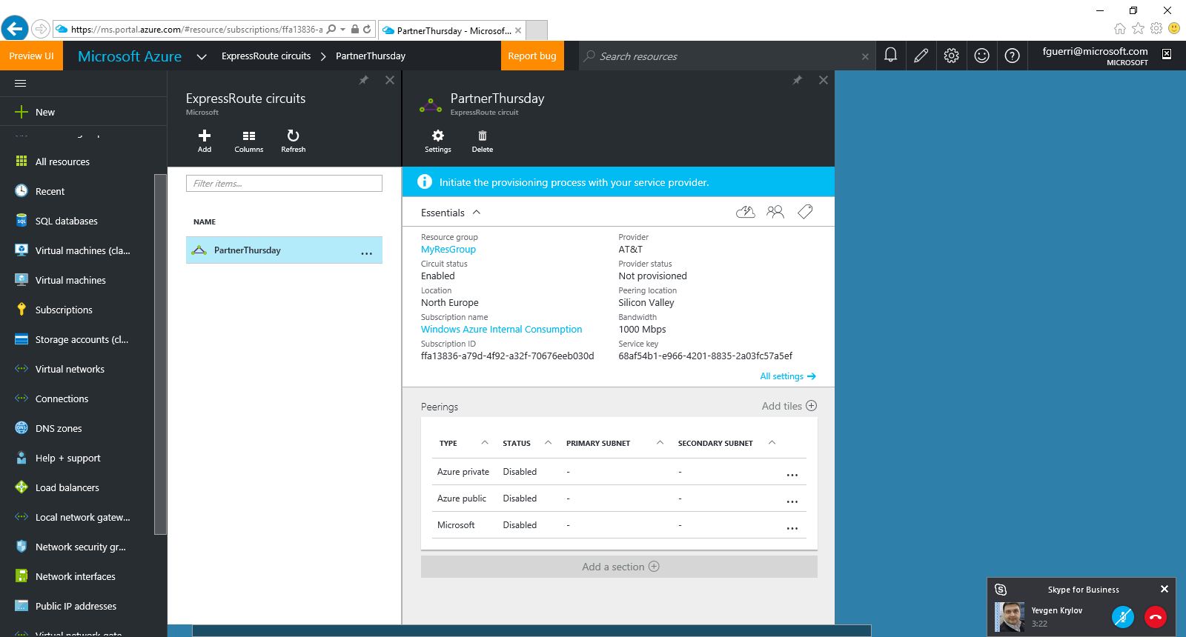
Azure Portal: Create Service Key

Slide 22
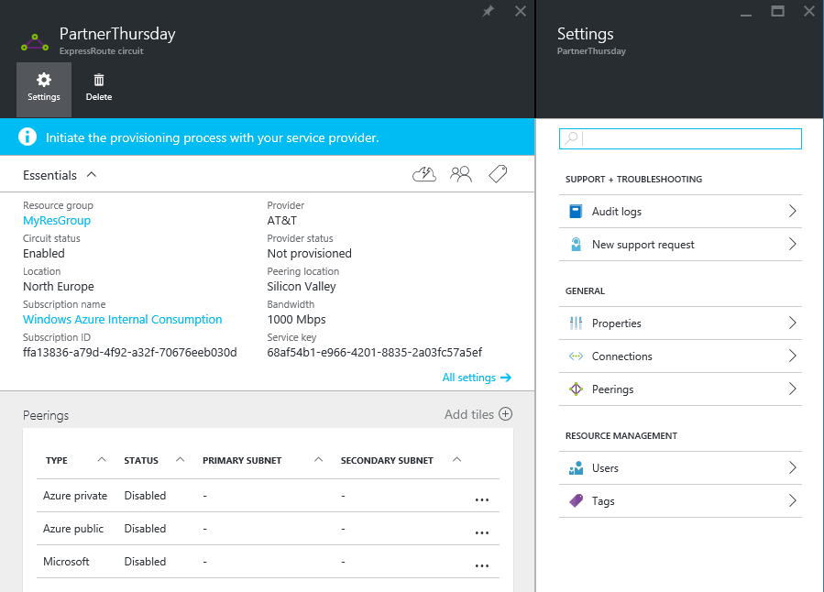
Azure Portal: Complete Configuration
Connect Vnet Gateways
Configure peerings

Slide 23
Best Practices: Do’s and Don'ts
Do
Add ExpressRoute into every conversation and start early
ExpressRoute Premium must be included with Office 365, Skype for Business and CRM Online
Be clear on the pricing model – there’s always a MSFT port and a connectivity carrier charge
Understand the workload and bandwidth requirements (can scale up but not down)
Identify and engage Microsoft field, provide us details on who you spoke with, what next steps and how we can help
Hold joint meetings with customer, Microsoft team and partner sales teams involved to assist with technical design
Escalate level 300+ questions to Microsoft ExpressRoute technical teams if needed
Direct customers to the ExpressRoute “user guide” site to learn more about ExpressRoute
Don‘t
Don’t try to outsmart the speed of light
Don‘t quote pricing for Microsoft, send customers to https://azure.microsoft.com/en-us/pricing/details/expressroute/ and/or direct them to their Microsoft account teams
Don’t connect separate companies to a single ER circuit

Slide 24

References
Awesome Web Links for More Information
ExpressRoute Technical Documentation: https://azure.microsoft.com/en-us/documentation/services/expressroute/
ExpressRoute for Office 365 Planning tools: https://azure.microsoft.com/en-us/documentation/articles/expressroute-prerequisites/#office-365-specific-requirements
ExpressRoute FAQ: https://azure.microsoft.com/en-us/documentation/articles/expressroute-faqs/
ExpressRoute prerequisites: https://azure.microsoft.com/en-us/documentation/articles/expressroute-prerequisites/
Other Related Services
Azure Virtual Networks: https://azure.microsoft.com/en-us/documentation/services/virtual-network/
Network Security Groups: https://azure.microsoft.com/en-us/documentation/articles/virtual-networks-nsg/
User Defined Routing: https://azure.microsoft.com/en-us/documentation/articles/virtual-networks-udr-overview/
Azure Virtual Gateways: https://azure.microsoft.com/en-us/documentation/services/vpn-gateway/
Site-to-Site VPNs: https://azure.microsoft.com/en-us/documentation/articles/vpn-gateway-site-to-site-create/
Notes:
Most of these links are on the Azure.com website under the documentation heading covering many of the topics I've discussed today. There are links to Getting Started and How To’s that are very informative. Most of the examples we’ve seen today are from the bottom link, Microsoft Cloud Services and Network Security, a Best Practices white paper the link takes you to high level overviews, some of what we’ve covered today, and links to detailed instructions on how to build the each of the examples I’ve discussed today and more. The detailed examples use both the classic PowerShell scripting and the new ARM template methods.
Ok, with that, I thank you for your time and interest in these topics. Good bye and happy networking with Azure and Azure Virtual Networks!

Slide 25
Contacts – expressroutepartner@Microsoft.com
Americas
Kevin Lopez - PSE kevlopez@microsoft.com
Jaime Schmidtke – PSE jaimesc@microsoft.com
Ron Abellera – Technical ronabel@microsoft.com
Kevin Sullivan – Technical kevinsul@microsoft.com
APAC
Paul Laverty - PSE plaverty@microsoft.com
Lina Sharii – PSE lisharii@microsoft.com
Lakshmi Krishnamurthy – Technical (India) lkrishna@microsoft.com
Nozomu Hirose – Technical (Japan & GCR) nhirose@microsoft.com
Jay Swaminathan – Technical (SEA & Korea) jaswamin@microsoft.com
Rudy Maritz – Technical (ANZ) rumaritz@microsoft.com
EMEA
Christophe Le Roux - PSE chleroux@microsoft.com
Richard Warner - PSE riwarn@microsoft.com
Sally Mahamdeh – Technical sallym@microsoft.com
Federico Guerrini – Technical fguerri@microsoft.com

Slide 26

Q & A

Slide 27
Thank you!

